Slide 1
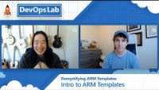
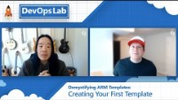
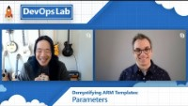
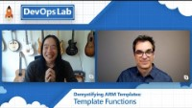
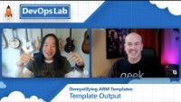
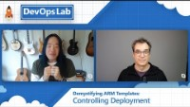
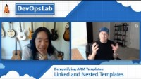
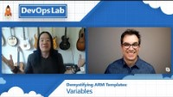

Lab#13 – Deploy Azure Resource manager-ctn
More to do and to know
#2: Creating Your First Template
#3: Parameters
#4: Template Functions
ARM Series #1: Introduction
#5: Variables
#6: Template Output
#7: Controlling Deployment
#8: Linked and Nested Templates

